Slide 1
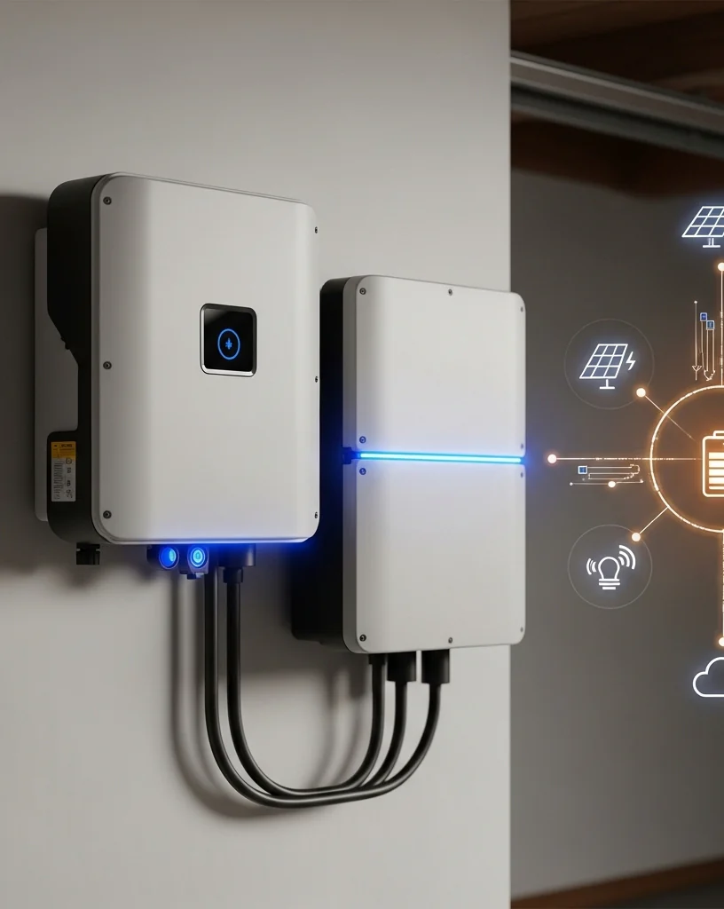

Residential Energy storage systems
CRC R330

Slide 2
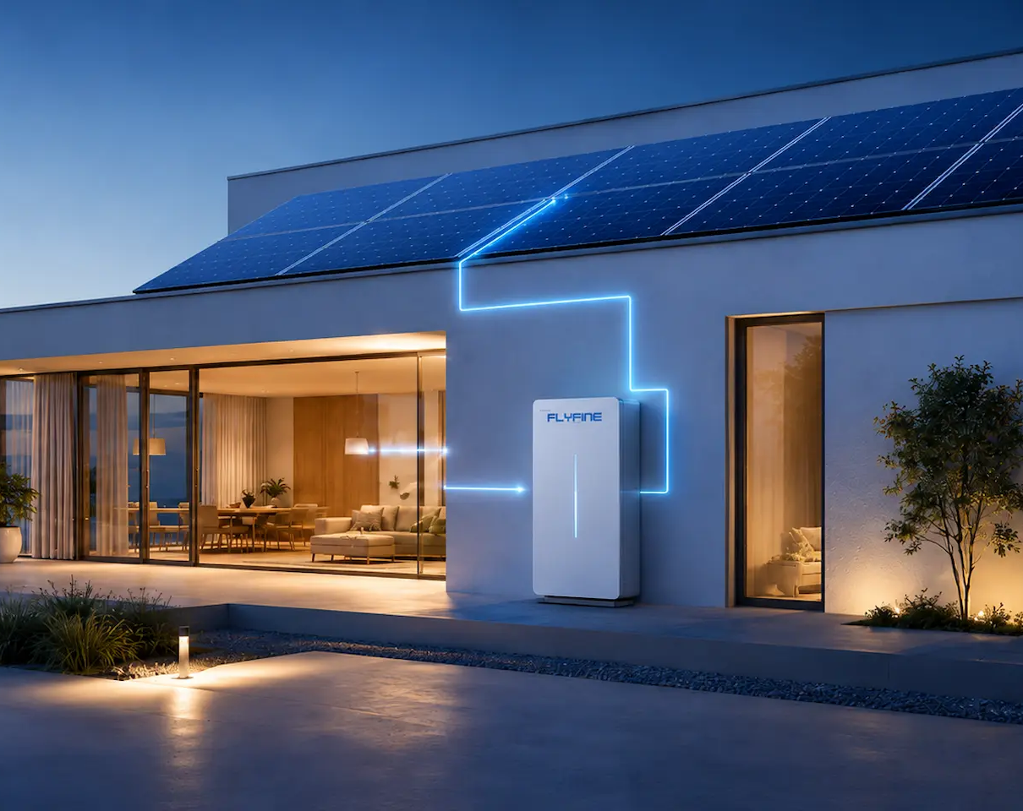
AGENDA
What is an energy storage system?
Where can an ESS be installed?
How large of an ESS system can be installed?
Additional safety features.

Slide 3
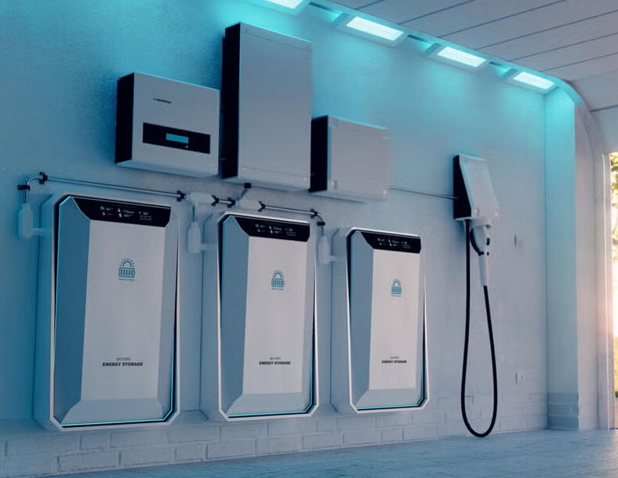
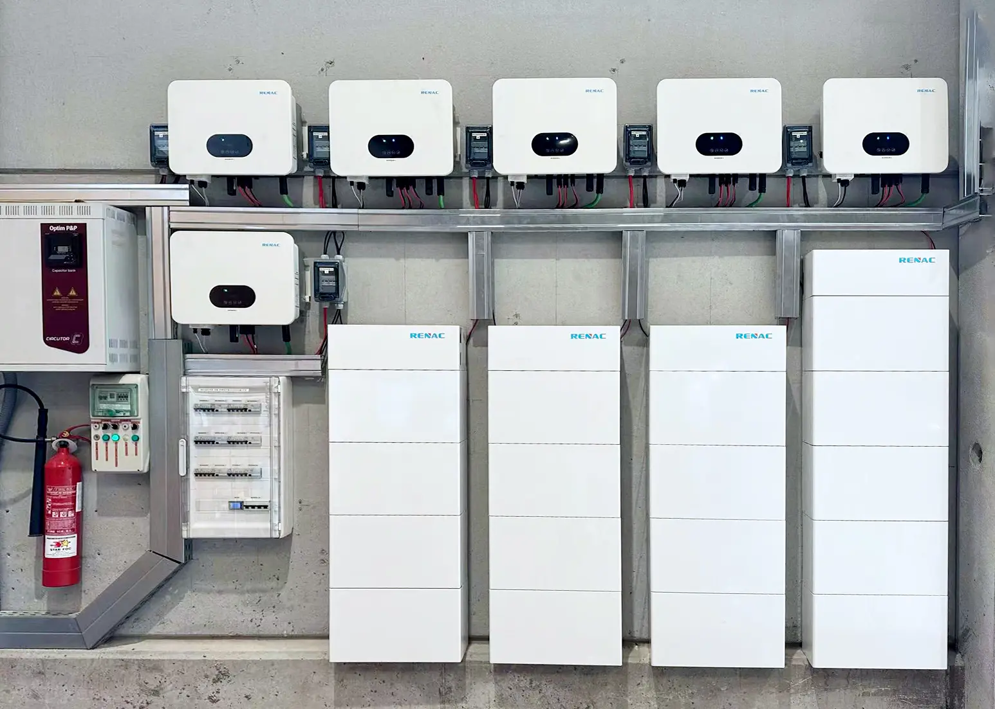
What is an energy storage system?
One or more devices installed as a system capable of storing energy and providing electrical energy into the premises wiring system or an electric power production and distribution network.
Informational Note No. 1: An ESS(s) can include but is not limited to batteries, capacitors, and kinetic energy devices (e.g., flywheels and compressed air). An ESS(s) can include inverters or converters to change voltage levels or to make a change between an ac or a dc system.
Informational Note No. 2: These systems differ from a stationary standby battery installation where a battery spends the majority of the time on continuous float charge or in a high state of charge, in readiness for a discharge event.
CEC 100 Definitions

Slide 4
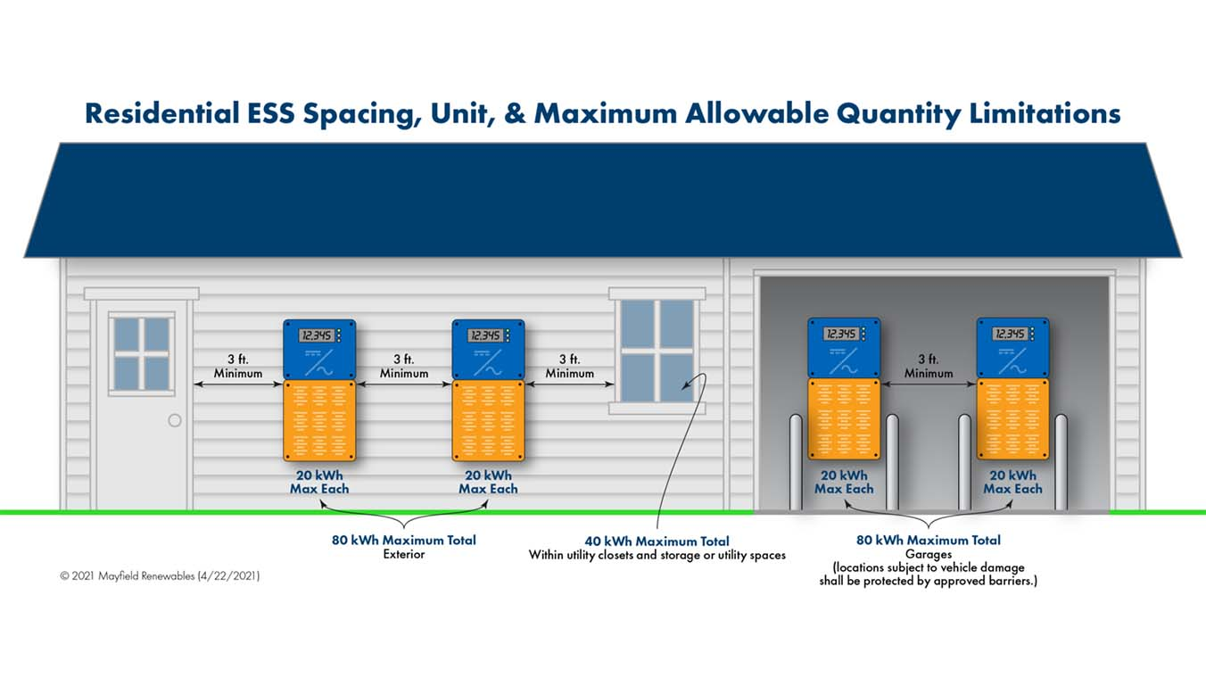
Where can an ESS be installed?
  ESS may be installed on exterior walls or inside of detached garages and accessory buildings; on exterior walls of a dwelling; or inside of attached garages, utility closets, utility storage and basements with required fire separation between the dwelling and the location of the ESS. The ESS cannot be installed in sleeping rooms, closets or spaces that open directly into habitable spaces of the dwelling.
  ESS that has the potential to emit toxic gases shall not be installed within in dwellings or attached garages.
  Individual ESS also must maintain 3 feet of separation from each other and all doors and windows entering the dwelling. The separation of the individual ESS may be reduced if the product is listed for a reduced separation.
  CRC R330.3-4

Slide 5
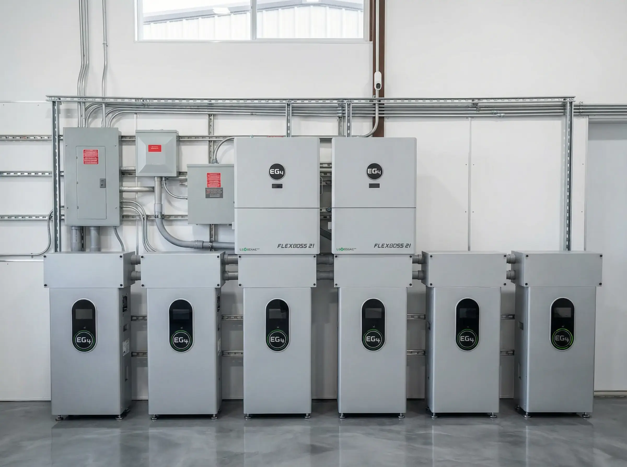
How large of an ESS system can be installed?
TABLE R330.5 MAXIMUM AGGREGATE RATINGS OF ESS
LOCATION | MAXIMUM AGGREGATE RATINGS (kWh) | INSTALLATION REQUIREMENTS
Within utility closets, basements, and storage or utility spaces located within dwellings | 40
In attached garages | 80
On or within 3 feet of exterior walls of dwellings and attached garages | 100
On or within 3 feet of exterior walls of dwellings and attached garages | 200 | Exterior walls and eaves are constructed with noncombustible surfaces
In detached garages and detached accessory structures | 200
In detached garages and detached accessory structures | 600 | Detached garage or detached accessory structure is a minimum 10 feet away from property lines and dwellings
Outdoors on the ground | 200 | ESS is a minimum 3 feet away from property lines and dwellings
Outdoors on the ground | 600 | ESS is a minimum 10 feet away from property lines and dwellings
The maximum allowable size of a single ESS device is 20kWh and the entire ESS shall not exceed 80 kWh. If the ESS is installed in a utility closet, utility storage, or basement of a dwelling, entire ESS shall not exceed to 600 kWh.
CRC R330.5

Slide 6
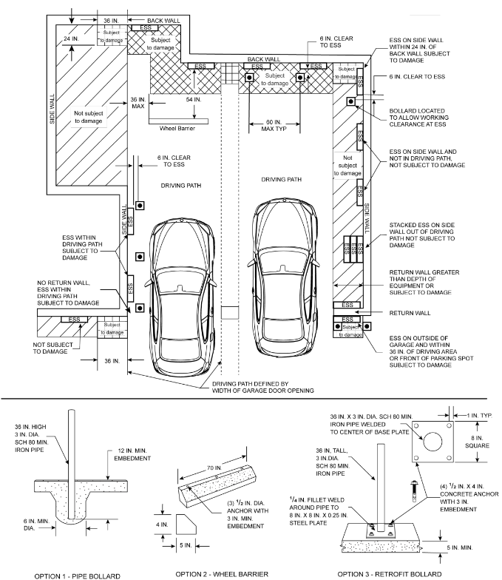
Additional safety features.
The following may be need to install an ESS:
Smoke alarms/heat detectors if installed in a dwelling, basement or in attached garage.
Ventilation if the ESS can produce hydrogen or other flammable gases.
Bollards, wheel barriers or other vehicle impact protection if installed in a vehicle path of travel. See attached diagram of requirements for ESS installed in garages.
Proper signage and placards.
The installation and maintenance of ESS equipment and all associated wiring and interconnections shall be performed only by qualified persons.
All energy storage systems (ESS) shall comply with the applicable provisions of the California Residential code R330, California Electrical Code 706 and all other applicable codes.

Slide 7
THANK YOU
Created by:
Austin Crowell
Shasta-Cascade ICC Chapter Education Chair
ACrowell@bpr-grp.com
530.264.8493
Presented by:
Adam Kingsley
Shasta-Cascade ICC Chapter Treasurer
akingsley@buttecounty.ca.gov
530.552.3658

